Slide 1
Multiple Access Control /
Media Access Control
( MAC )
Protocols

Slide 2
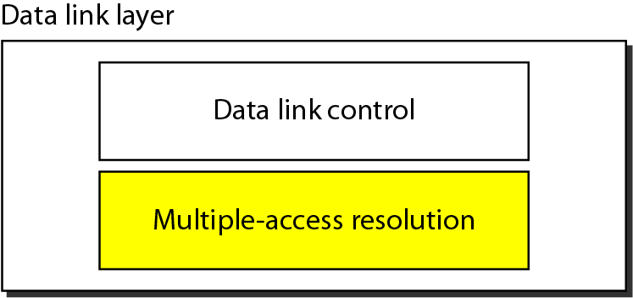
Data link layer divided into ………

Slide 3
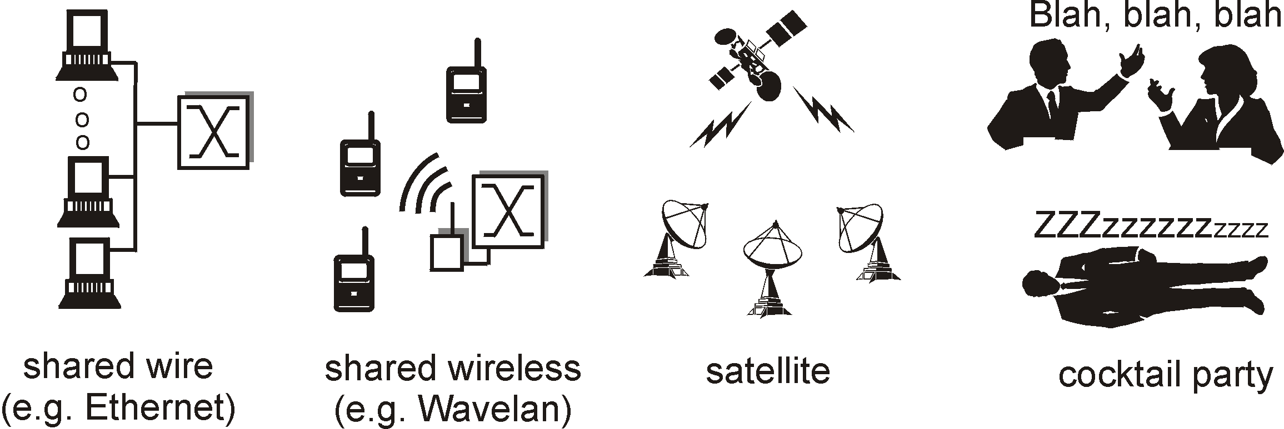
Multiple Access Links and Protocols
Two types of “links”:
point-to-point
PPP for dial-up access
point-to-point link between Ethernet switch and host
broadcast (shared wire or medium)
Old-fashioned Ethernet
upstream HFC
802.11 wireless LAN

Slide 4
Multiple Access Communications
Shared media basis for broadcast networks
Inexpensive: radio over air; copper or coaxial cable
M users communicate by broadcasting into medium
Key issue: How to share the medium?
3
2
4
1
Shared multiple
access medium
M
5
…

Slide 5
Multiple Access protocols
single shared broadcast channel
two or more simultaneous transmissions by nodes: interference
collision if node receives two or more signals at the same time
multiple access protocol
distributed algorithm that determines how nodes share channel, i.e., determine when node can transmit
communication about channel sharing must use channel itself!
no out-of-band channel for coordination

Slide 6
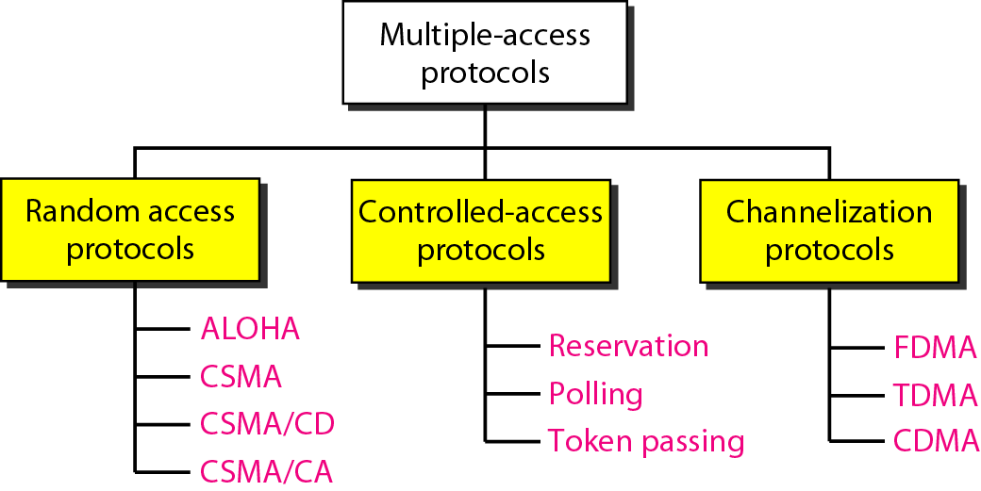
Multiple-access protocols

Slide 7
Multiple-access protocols

Slide 8
Random Access protocols
Let us study one MAC protocol
as
an example

Slide 9
Random Access protocol #3
Carrier Sense Multiple Access with Collision Detection
(CSMA/CD)

Slide 10
Random Access Protocols
When node has packet to send
transmit at full channel data rate R.
no a priori coordination among nodes
two or more transmitting nodes ➜ “collision”,
random access MAC protocol specifies:
how to detect collisions
how to recover from collisions (e.g., via delayed retransmissions)
Examples of random access MAC protocols:
slotted ALOHA
ALOHA
CSMA, CSMA/CD, CSMA/CA

Slide 11
RANDOM ACCESS
In random access or contention methods,
No station is superior to another station and none is
assigned the control over another.
No station permits, or does not permit, another
station to send.
At each instance, a station that has data to send uses a procedure defined by the protocol to make a decision on whether or not to send.

Slide 12
RANDOM ACCESS
In a random access method, each station has the right to the medium without being controlled by any other station.
If more than one station tries to send, there is an access conflict- collision -and the frames will be either destroyed or modified.

Slide 13
RANDOM ACCESS
To avoid access conflict or to resolve it when it happens, each station follows a procedure that answers the following questions:
When can the station access the medium?
What can the station do if the medium is busy?
How can the station determine the success or failure of
the transmission?
What can the station do if there is an access conflict?

Slide 14
CSMA
To minimize the chance of collision and, therefore, increase the performance, the CSMA method was developed.
The chance of collision can be reduced if a station senses the medium before trying to use it.

Slide 15
CSMA
CSMA requires that each station first listen to the medium (or check the state of the medium) before sending.
In other words, CSMA is based on the principle "sense before transmit" or "listen before talk.”

Slide 16
CSMA
CSMA can reduce the possibility of collision, but it cannot eliminate it.
The reason for this is (shown in Figure 12.8.) stations are connected to a shared channel (usually a dedicated medium).

Slide 17
CSMA
The possibility of collision still exists in CSMA because of propagation delay;
when a station sends a frame, it still takes time for the first bit to reach every station and for every station to sense it.
In other words, a station may sense the medium and find
it idle, only because the first bit sent by another station has not yet been received.

Slide 18
CSMA
In Figure 12.8.
At time t₁ , station A senses the medium and finds it idle, so it sends a frame.
At time t₂ (t₂ > t_{I}) station Z senses the medium and finds it idle because, at this time, the first bits from station A have not reached station Z.
Station Z also sends a frame. The two signals collide and both frames are destroyed.

Slide 19
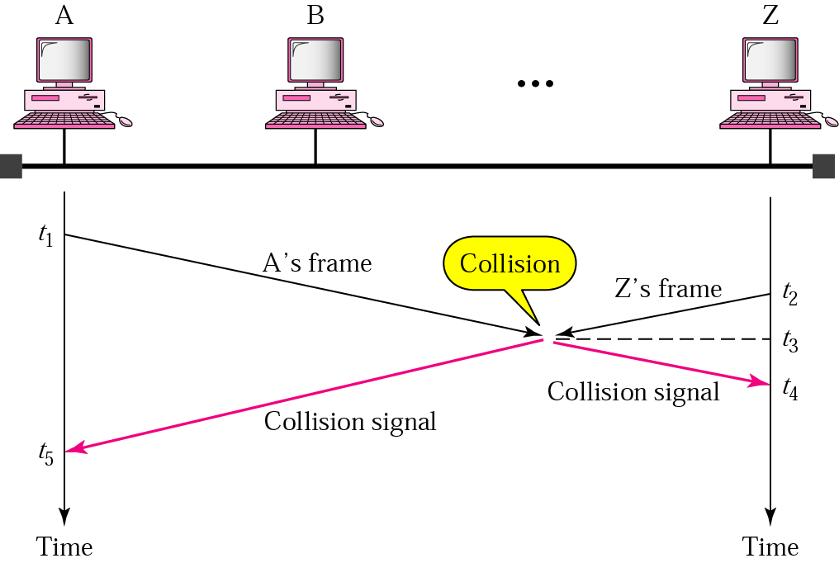
Figure 12.8 Collision in CSMA

Slide 20
CSMA/CD
Step 1: A station with a frame to transmit waits until the channel is silent.
Step 2: When channel becomes silent, station transmits but continues to listen for collisions.
Step 3: If a collision occurs, the station aborts the transmission, waits for a random time to reattempt the transmission time.
If the collision doesn't occur within 2 propagation delay times [mini-slot time], then station knows that it has captured the channel

Slide 21
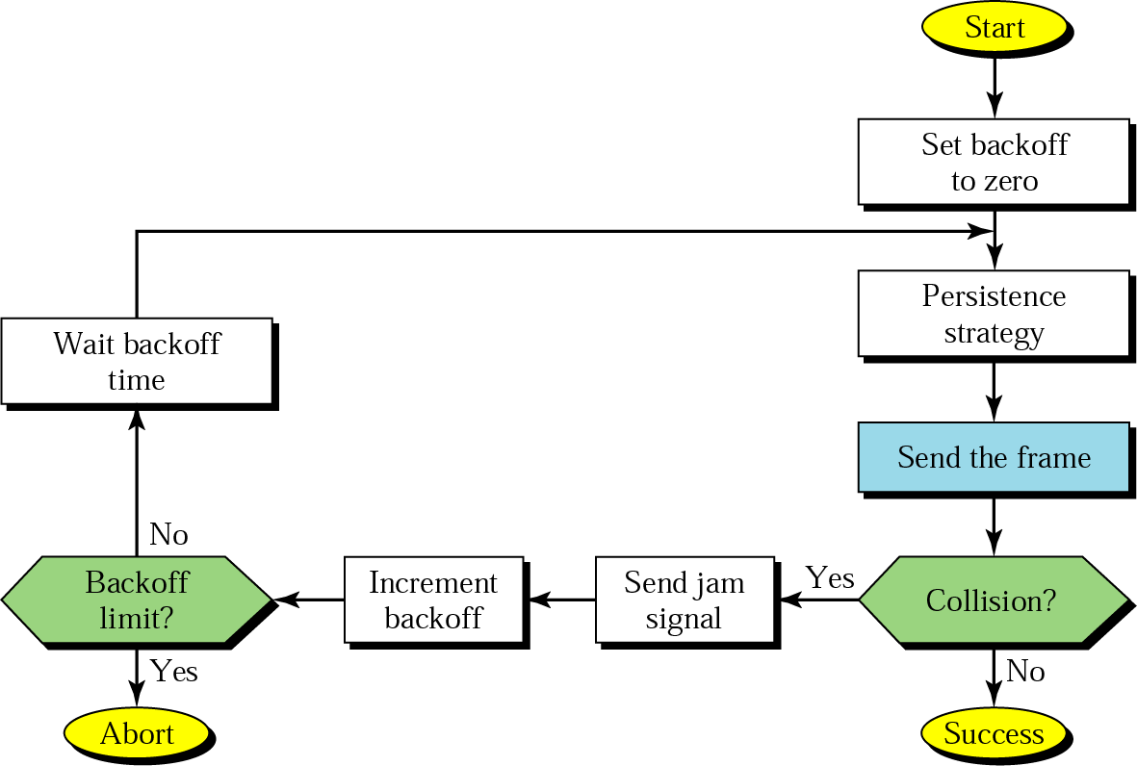
Figure 13.7 CSMA/CD procedure

Slide 22
What is the significance of jam signal in CSMA/CD ?
If the station hears a collision, it sends jam signal to the line to inform other stations of the situation and to alert them that a collision has occurred

Slide 23
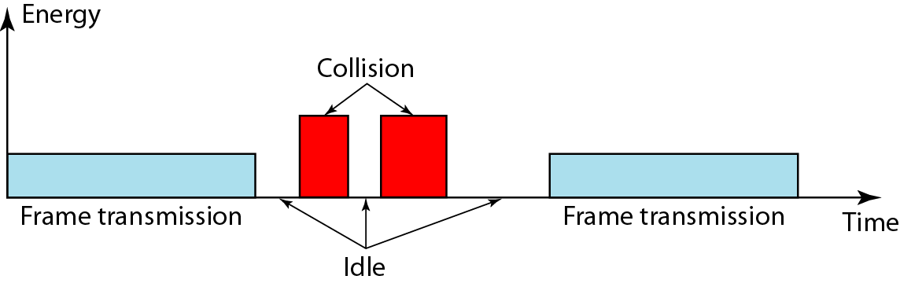
How is collision detected in CSMA/CD?
Station uses a separate port ( other than data port ) to detect collision.
In normal condition, collision detection port receives the normal signal or no signal.
When collision occurs, it receives higher energy signal.
Figure 12.15 Energy level during transmission, idleness, or collision

Slide 24
Ethernet CSMA/CD algorithm
1. NIC receives datagram from network layer, creates frame
2. If NIC senses channel idle, starts frame transmission. If NIC senses channel busy, waits until channel idle, then transmits.
3. If NIC transmits entire frame without detecting another transmission, NIC is done with frame !
4. If NIC detects another transmission while transmitting, aborts and sends jam signal
5. After aborting, NIC enters binary (exponential) backoff:
after mth collision, NIC chooses K at random from {0,1,2, …, 2^{m}-1}. NIC waits K·512 bit times, returns to Step 2
longer backoff interval with more collisions

Slide 25
CSMA/CD is not suitable for wireless LAN
Why ?

Slide 26
In case of wireless medium, it is difficult to sense the collision, because collided signal strength may decrease due to propagation
Hence CSMA/CD is not suitable for wireless LANs
What is the solution??
CSMA / CA Protocol

